Slide 1
Sharing Experiences & Challenges in Geospatial Partnerships
Workshop on
fostering partnerships with universities involved
in Geospatial Sciences & Research
Kavinda Gunasekara, PhD

Slide 2
Outline
Introduction to AIT
AIT’s mechanism
Introduction to Geoinformatics Center (GIC)
GIC’s strategies
Success story of building new partnerships and move forward
Personal experience from 2006 to present in 4 different contexts
What we can offer for Myanmar in Geospatial Science and Research
Notes:
Keywords: proactive

Slide 3
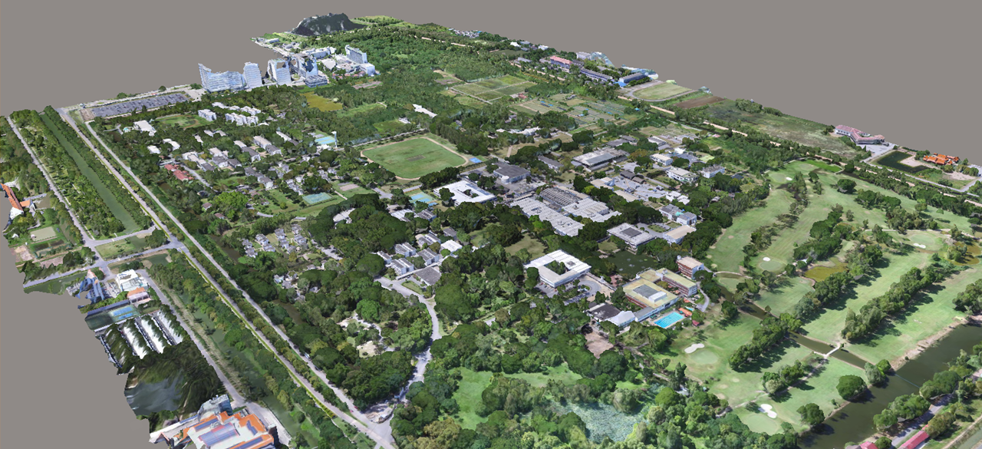

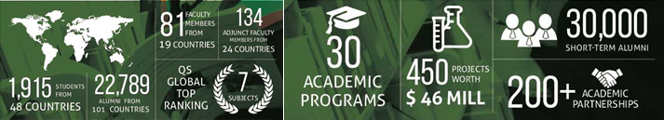
Establish in 1959 as a Post Graduate School
Catering for higher education in Asia

Slide 4
AIT President’s Message
“Today, as we approach our 60th Anniversary, we have over 1800 students from 45 countries on our beautiful suburban campus, and they are pursuing a stimulating education while having a vibrant international student life. Our research on issues relevant to this region and our connections to governments and NGOs are our core strengths. As I mentioned in my Vision Talk after I took office in September 2018, leveraging on these core strengths, AIT is moving smartly forward in the new era, by embracing innovation, by being international, by working with enterprises, by nurturing entrepreneurship, by caring for stakeholders, and by broadening support or I²E²S² for short.”
What is I²E²S² ?
Innovation, International, Enterprises, Entrepreneurship, Stakeholders, and Support

Slide 5
Schools of AIT
School of Engineering & Technology www.set.ait.ac.th
  Remote Sensing and GIS Program
  Data Science and AI Center Program
School of Environment, Resources & Development www.serd.ait.ac.th
School of Management www.som.ait.ac.th
AIT Offers
  Masters degrees: MBA, MEng, MSc
  Executive Master Degree Programs
  Doctoral Degrees: DEng, DTechSc, PhD
  Diploma and Certificate Programs
  An intensive English language and academic Bridging Program
  Non-degree continuing education courses for practicing professionals

Slide 6
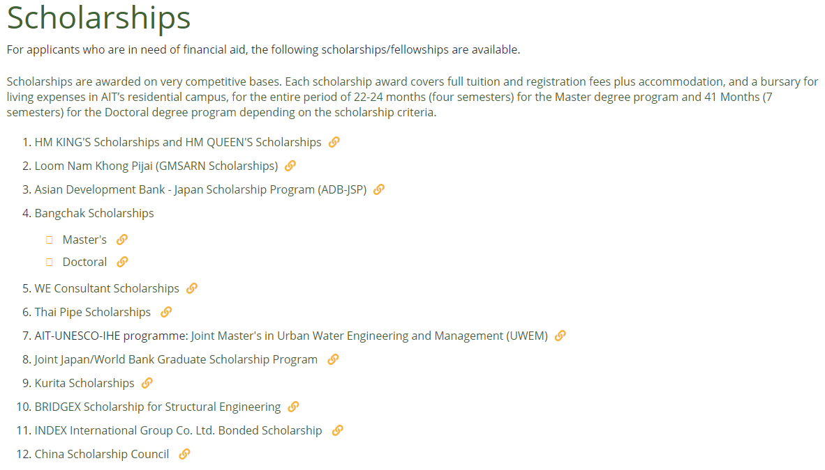
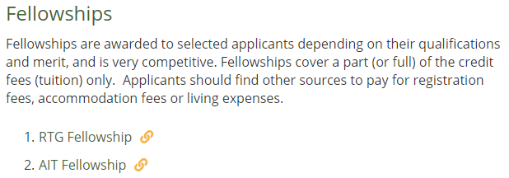
https://www.ait.ac.th/admissions/scholarships/

Slide 7
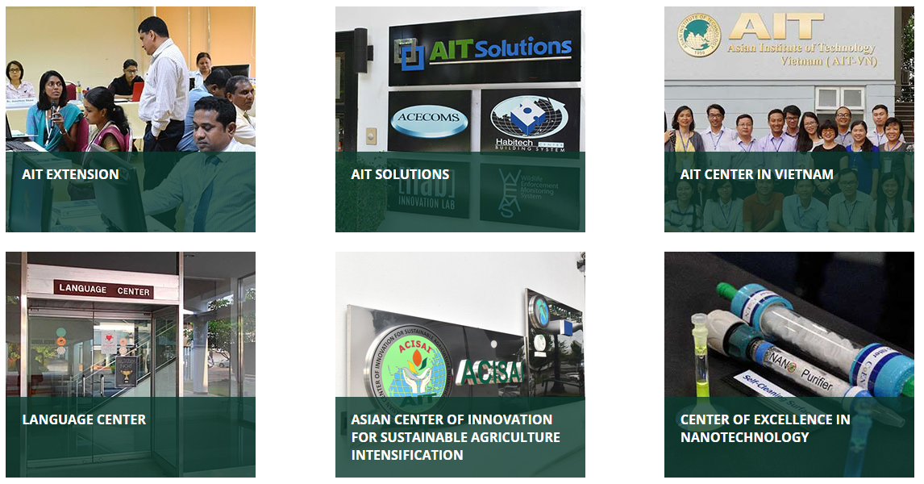
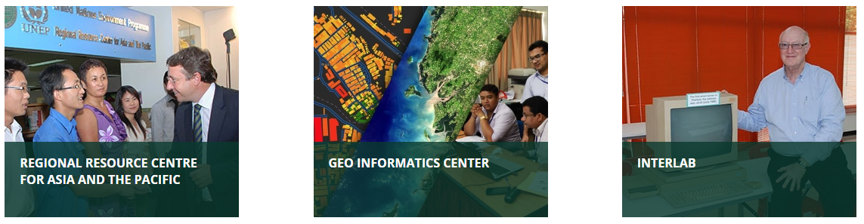
Outreach Centers of AIT

Slide 8
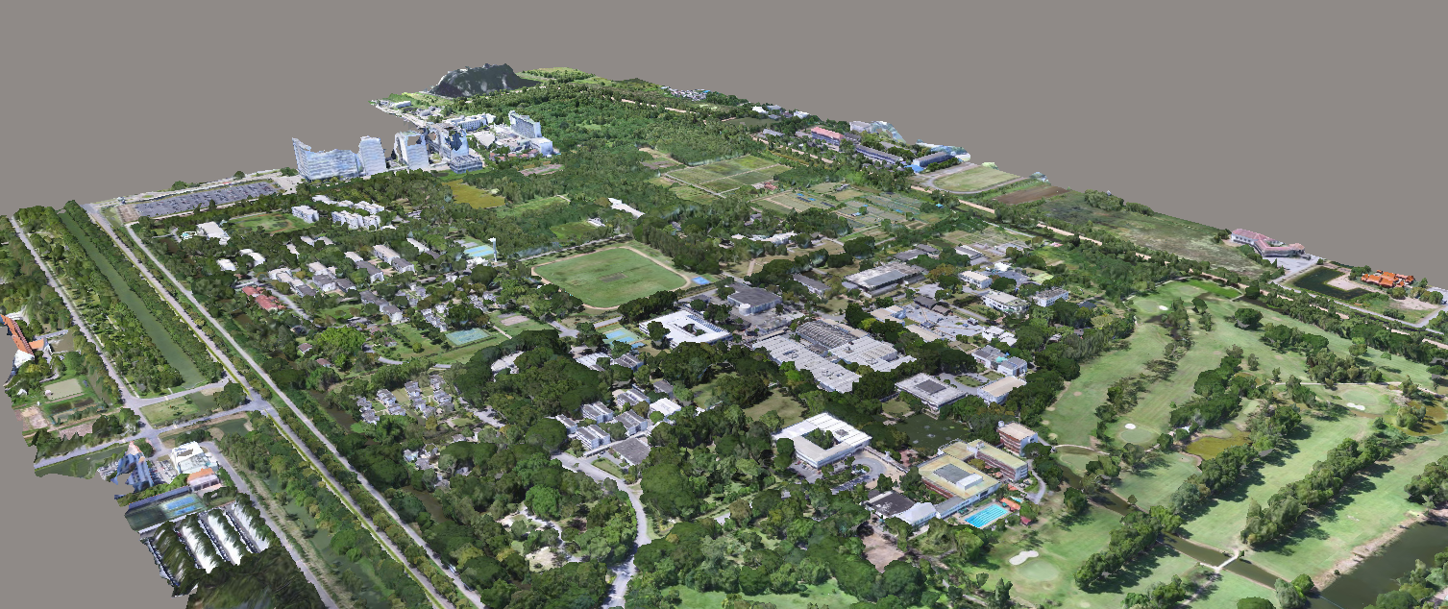

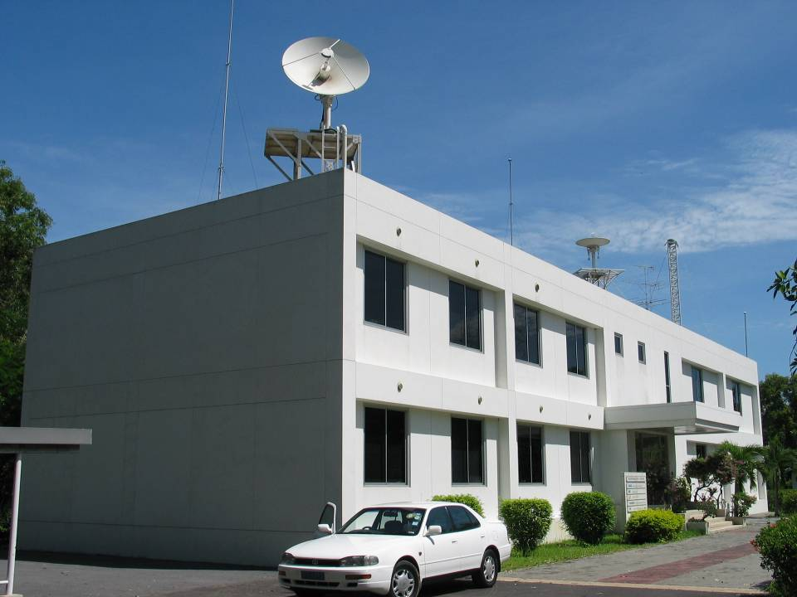
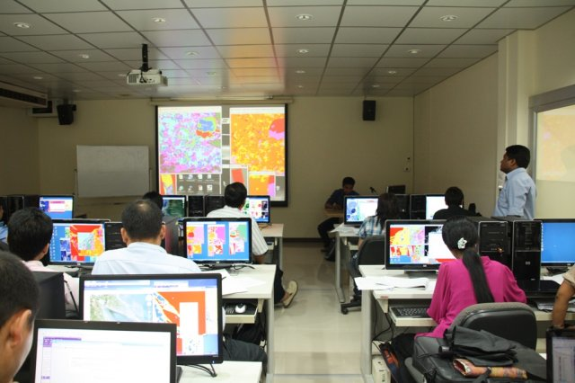
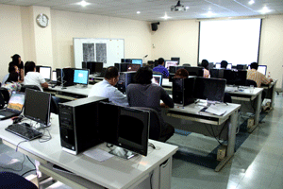
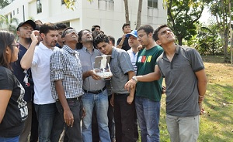





Our Expertise
Geoinformatics Center
Established in 1999

Slide 9
Our Expertise
Processing optical, radar & LIDAR data
Unmanned Aerial Vehicles (UAV)
Geospatial products combined with RS and GIS data
Satellite Imagery for environmental monitoring
Landuse and landcover change mapping, biomass estimation, crop monitoring, yield forecasting, drought monitoring, coastal erosion mapping and modeling and urban environmental modeling.
Floods, landslides, tropical cyclones, earthquakes and tsunami
Sentinel Asia - PDAN
Emergency response data
GIC organizes a number of training courses in a variety of fields
Practical courses led by experts

Slide 10
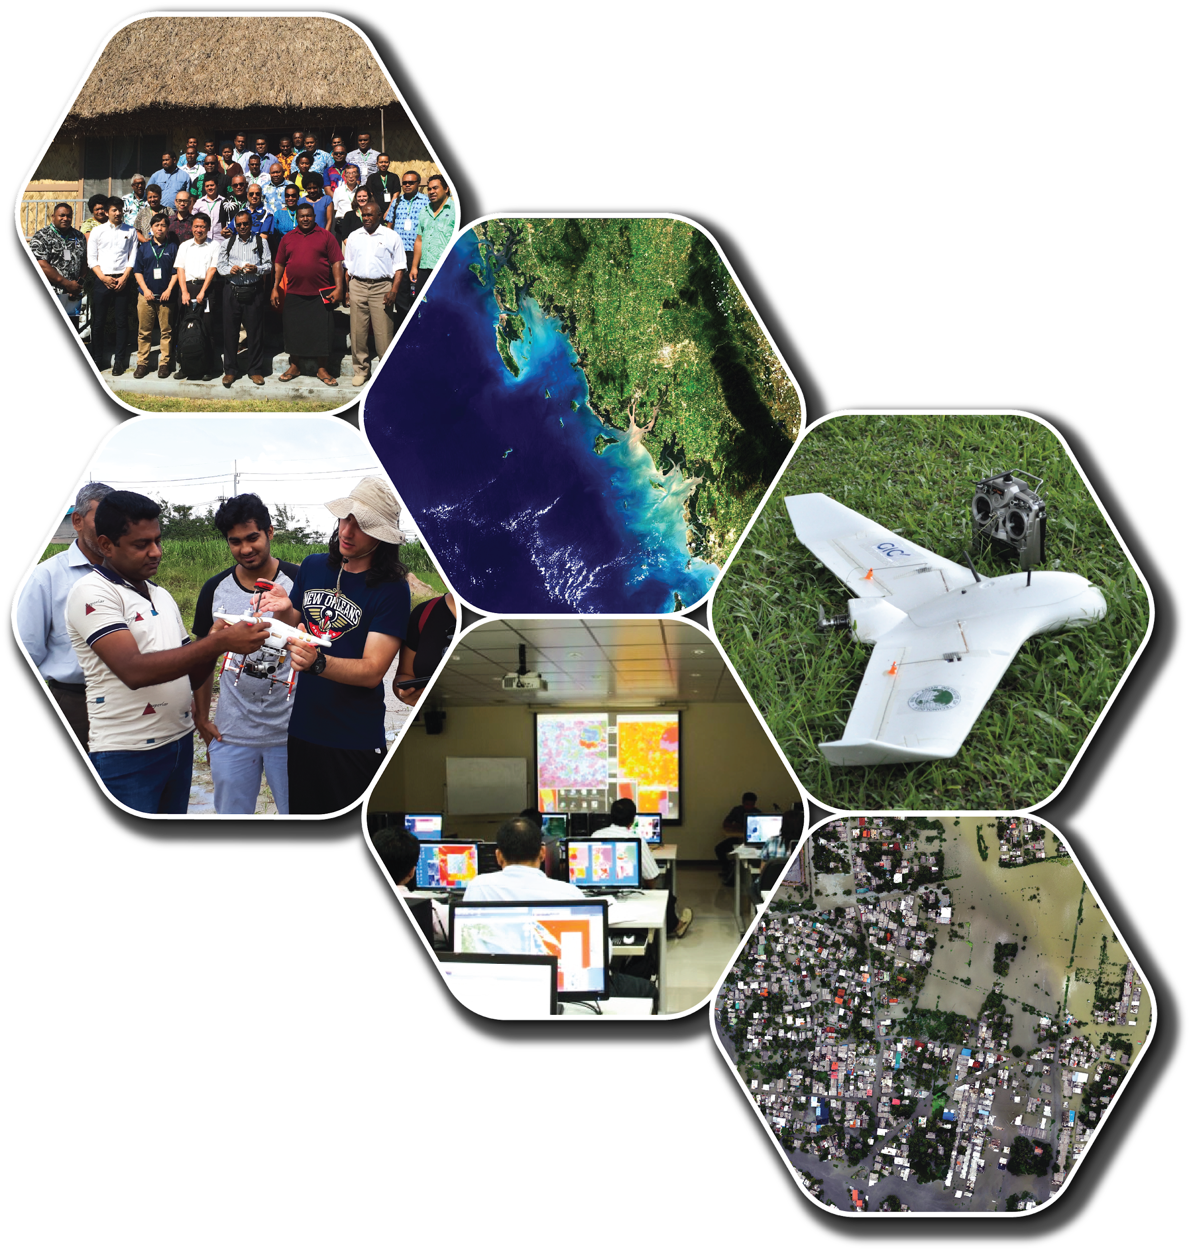
Our Activities
(A) Project Services
Hazard/Risk Assessment (Flood, Landslide, Cyclone and Earthquake)
Disaster (Satellite Data Analysis for Emergency Response)
Agriculture (Crop Monitoring, Drought Situation Analysis and Yield Forecasting)
Monitoring Infrastructure Projects Using UAVs
WebGIS Platform and Mobile App. Development
(B) Training Services
Remote Sensing and GIS Applications
UAV for Mapping
GNSS and its Applications
GIS for Disaster Risk Management
Crop Monitoring and Yield Forecasting Using Remote Sensing
Flood Modeling for Hazard and Risk Assessment
IoT for Agriculture

Slide 11
Ongoing/Upcoming Activities
Projects
Multi-hazard Risk Assessment in Uttarakhand, India – World Bank
Integrated Geospatial Platform for Disaster Risk Management, Uttarakhand, India - World Bank
Monitoring Health and Forecasting Yield of Rice Using RS Technologies – FAO
Highway Monitoring – Highway Department, Thailand
Risk Assessment of Six Natural Hazards at District Level, Tajikistan - UNDP
Smart Irrigation Technology Project, in Thailand and Sri Lanka (under discussion)
Research and Innovation
AI/Deep Learning in Remote Sensing Data processing
Cloud-Based Risk Assessment Platform
Earthquake Prediction (with Prof. Shunji Murai)
Development of Fixed-wing Drones
Integration of Low-cost GNSS receivers
IoT integration
Humanitarian Activities
Sentinel Asia and International Disaster Charter
Training/Capacity Building
Asia Regional Training/Workshop on the use of GIS for agricultural statistics – FAO
Training on GNSS – ICG/UNOOSA
IoT for Agriculture – Multi-lateral
Strengthening Agro-climatic Monitoring And Information System, Lao PDR – FAO and GCF
Regional Training on the Use of Drones/Satellite Imagery and GIS for Agriculture – FAO and ITU

Slide 12











Our Active Partners
Asian Disaster Reduction Center (ADRC), Japan
International Institute for Geo-information Science and Earth Observation (ITC), Univ. of Twente, Netherlands;
National Research Institute for Earth Science and Disaster (NIED), Japan;
Japan Aerospace Exploration Agency (JAXA), Japan;
Remote Sensing Technology Center of Japan (RESTEC), Japan;
Institute of Industrial Science (IIS), Univ. of Tokyo, Japan;
Pacific Disaster Center, Univ. of Hawaii, USA
Air Asia Survey, Japan
Kokusai Kogyo Co. Ltd., Japan
Beijing Piesat Information Technology Co. Ltd., China
GEO C&I Co. Ltd., Korea
JESEA, Japan
UNESCAP (LoI stage)

Slide 13
GIC’s challenges & strategies
As a Geospatial Science & Research Team

Slide 14
GIC’s challenges & strategies
How to survive with disruptive technologies
Maintaining staff
How to do appropriate research investments
Resources
Funding sources

Slide 15
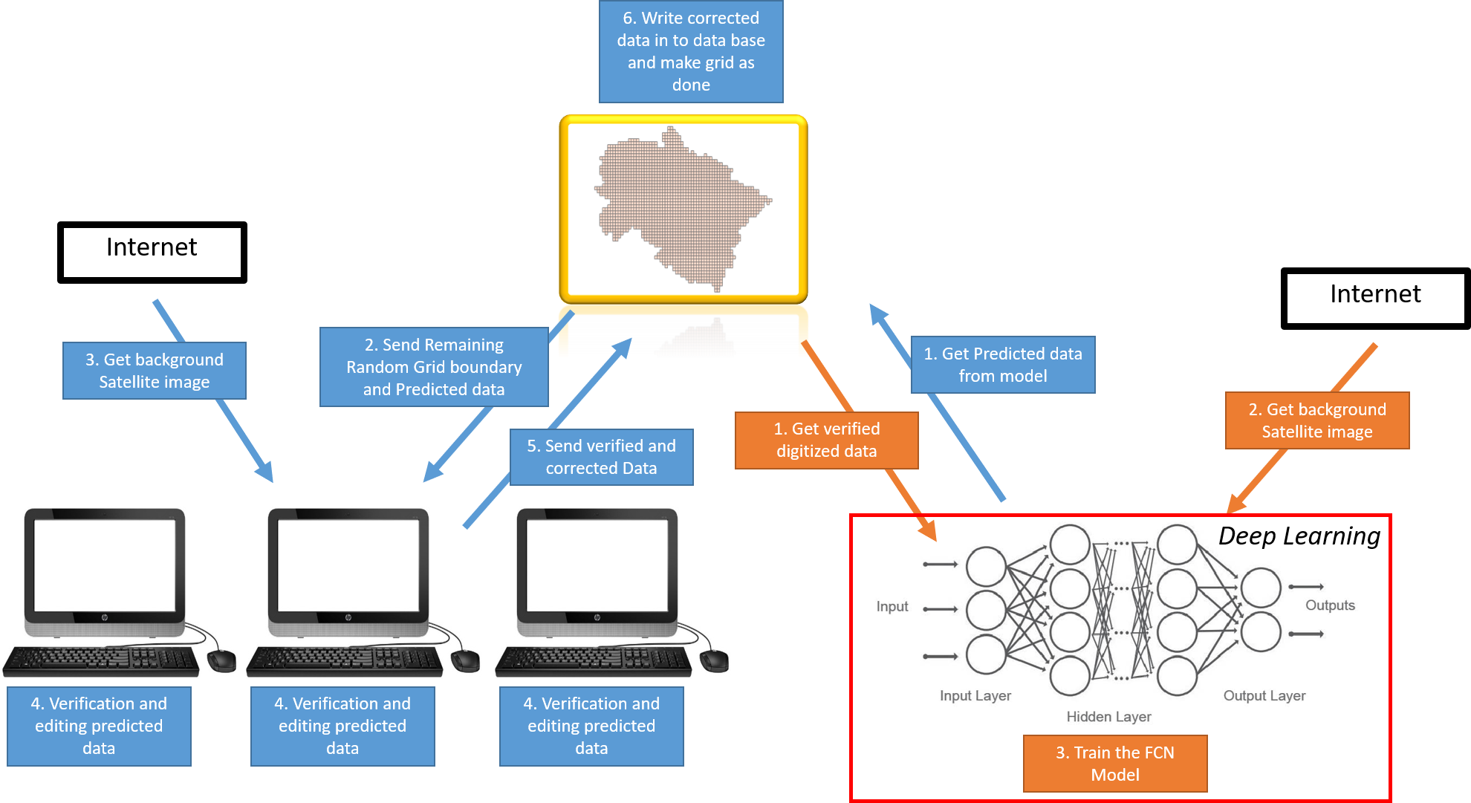
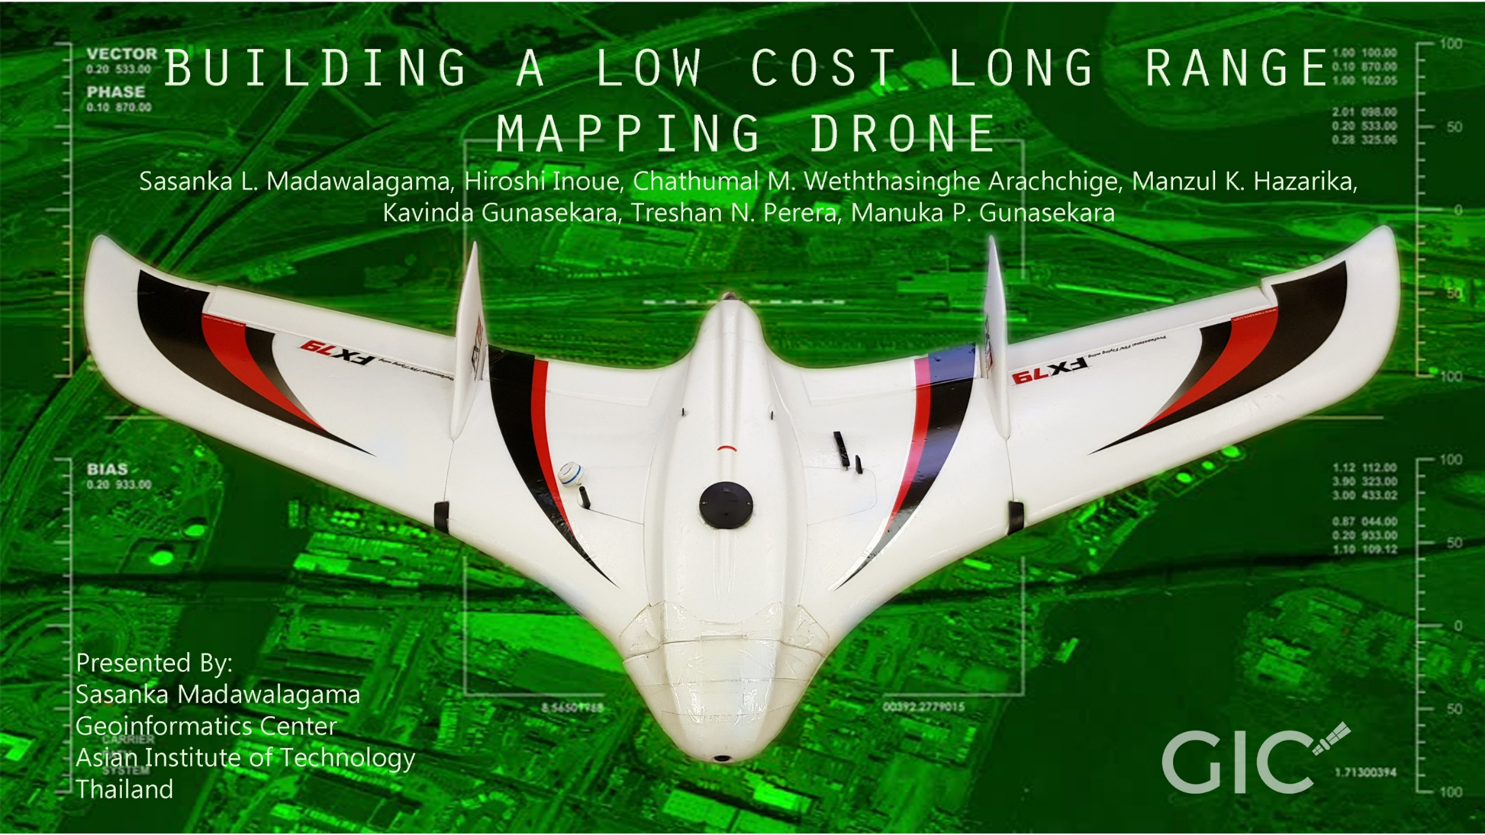
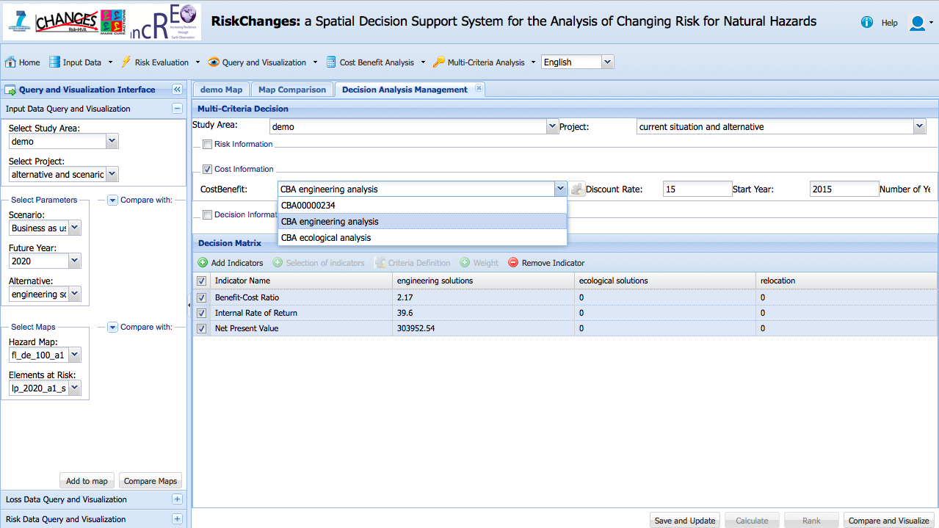
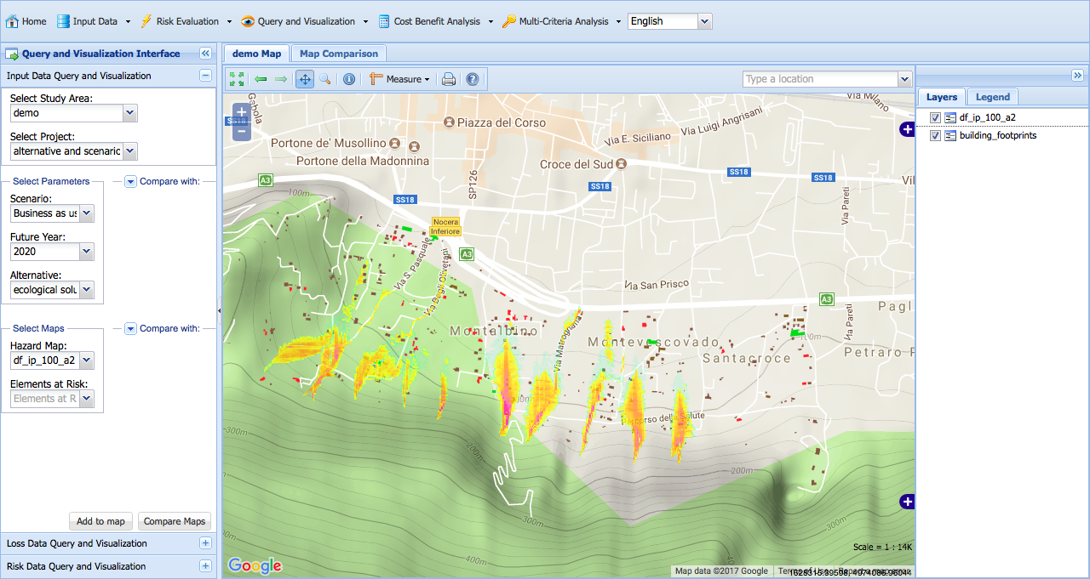
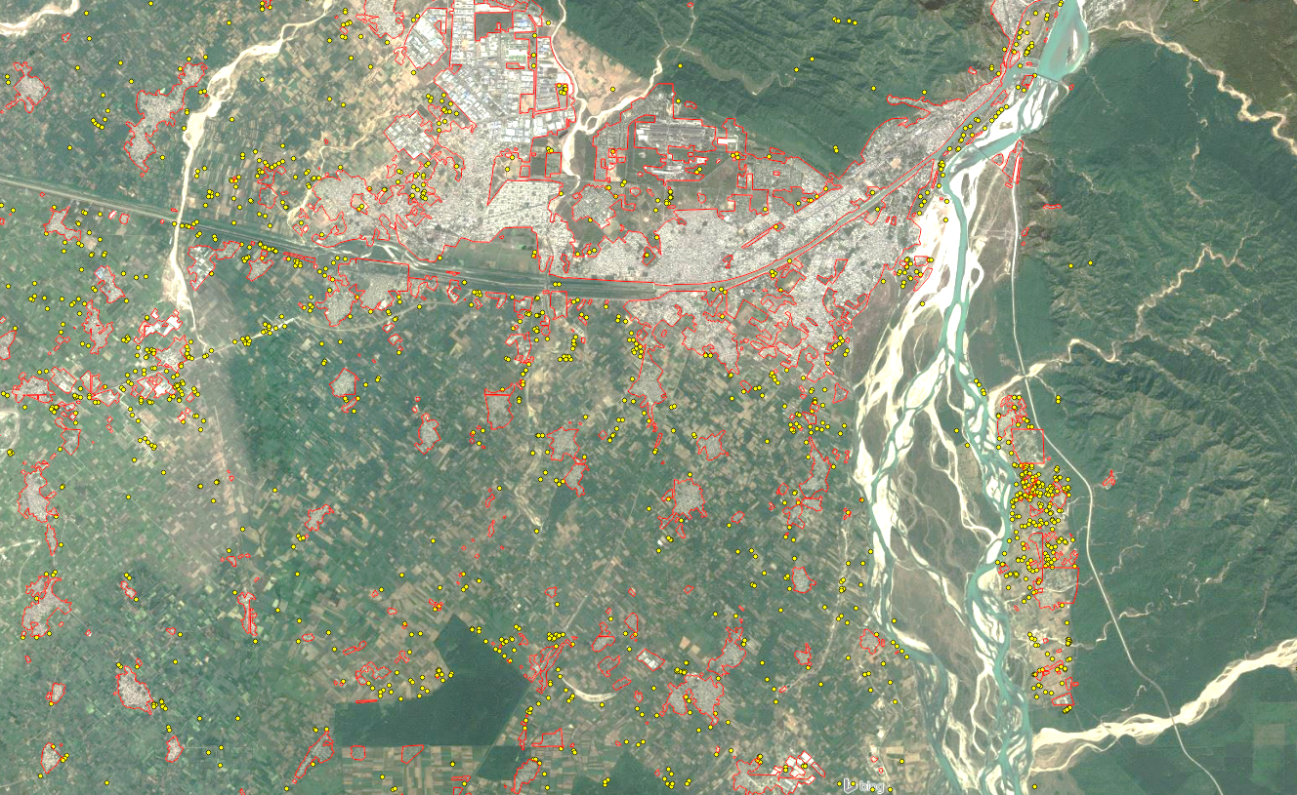
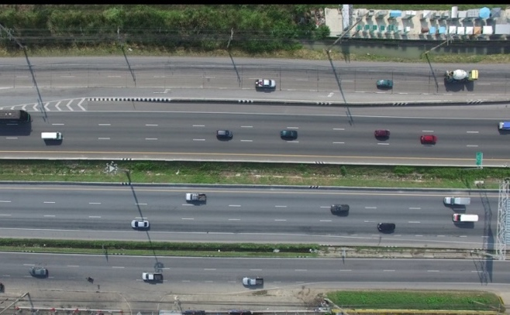
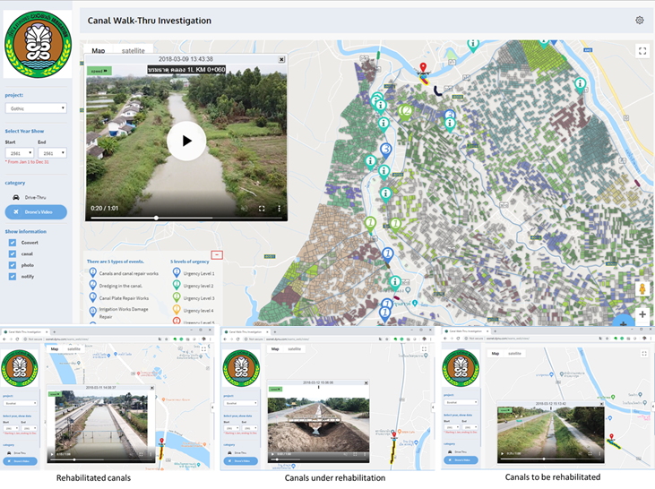
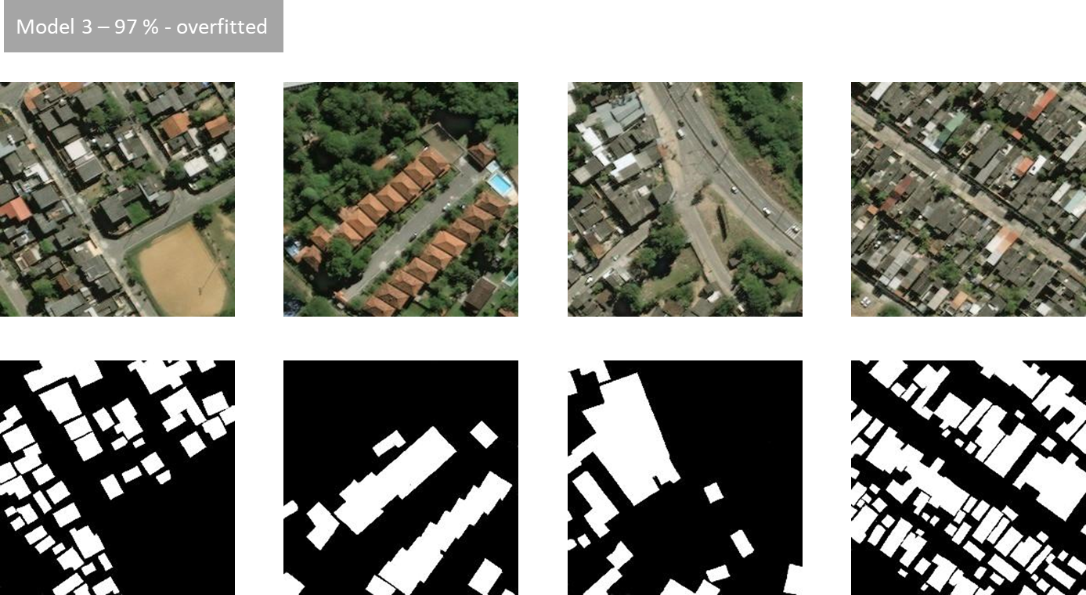
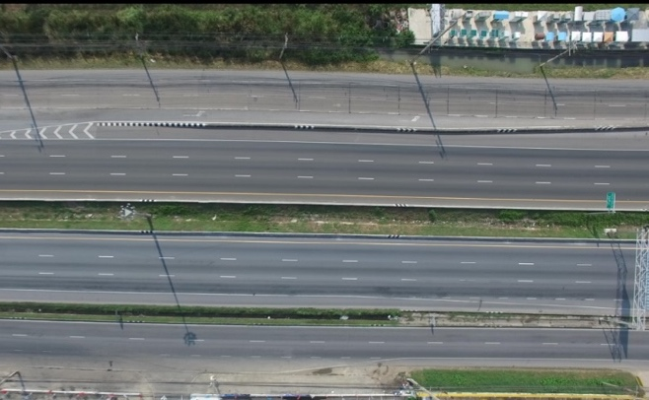
How to survive with disruptive technologies
GIC’s challenges & strategies
Development of cloud-based platforms
  Multi-hazard risk assessment with ITC, Netherlands
  Centralized platforms
Adopting Deep Learning/AI technologies for our expertise
Development of Fixed-wing drones and algorithms
Notes:
A disruptive technology is one that displaces an established technology and shakes up the industry

Slide 16
Maintaining staff
GIC’s challenges & strategies
Young researchers tend to leave for higher studies
Offer staff to engage in AIT academic program while working
Research conference opportunities and courage to research publications
Salary scale
Organization structure

Slide 17
How to do appropriate investment
GIC’s challenges & strategies
(GIC’s New Partnership Strategies)
Identify research and application of geospatial sciences in demand
Prototype analysis/application
Reach appropriate clients and show the potential integration
Scale-up the application
Relevance to SDG
Examples:
IoT initiatives (towards mapping)
MITR PHOL Sugarcane company (Mitr Phol Group is Thailand's and Asia's biggest sugar and bio-energy producer)
Notes:
IoT:

Slide 18
MITR PHOL expectations in the field of geoinformatics
Integrating Microwave Satellite Data for the sugar cane field monitoring.
Identifying Extent of the sugarcane fields
Height estimation of the sugarcane over the crop cycle
Monitoring the Health of the Sugarcane plant by RS/drones
Burnt Area identification
Capacity building on drone-based mapping using multispectral sensors
Capacity building on Microwave data processing
Utilization of low-cost GNSS receivers for their ongoing work

Slide 19
Resources
GIC’s challenges & strategies
Additional Human resources
  Internship students from various countries (Australia, Brazil, Japan, Sri Lanka, Thailand, USA, etc.)
  Internship students from various fields (geomatics, computer science, IoT, Policy research, etc.)
Maintain commercial software packages at educational rates
  ESRI (ArcMap, ArcMap Pro, Arc Server, ArcOnline)
  ENVI
  Bently Package
  Pix4D
  …………
High-end processing computers (4 GPUs)
Drones for mapping
GNSS equipment

Slide 20
Funding sources
GIC’s challenges & strategies
Competitive proposals in WB, UNDP, ADB, etc. in the area of geomatics and disaster
  Partnering with international and local universities and agencies
Consultancy opportunities from government departments under international loans
Research grants
Within known network

Slide 21
Success story of building new partnerships & way forward
A one story

Slide 22
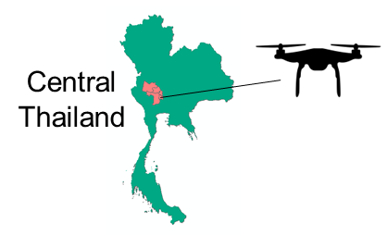
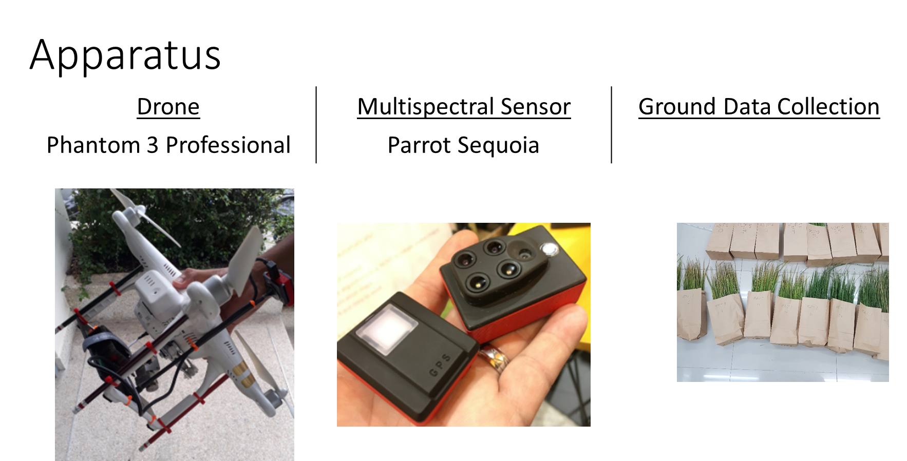
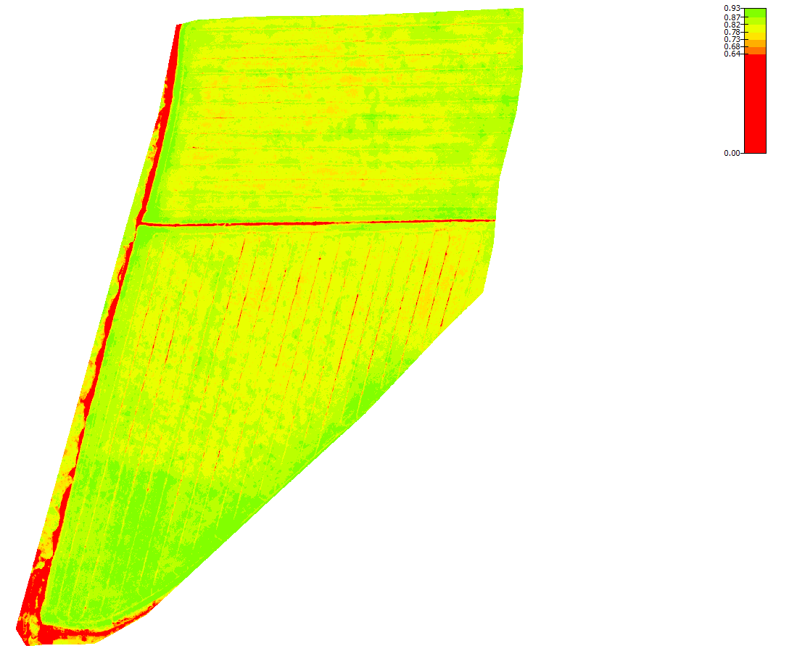

New partnership & way forward
A story
Free drone workshop ⇒
Reach by FAO & ITU Bangkok ⇒
Drone regional workshop with FAO and ITU ⇒
Pilot study on agriculture mapping ⇒
FAO e-agriculture forum in China ⇒
Executing capacity building training programs under FAO Laos - Strengthening Agro-climatic Monitoring and Information System (SAMIS) project
Potential collaboration with FAO Myanmar & Laos on Agro Ecological Zonation mapping activities

Slide 23
Personal experience
from 2006 to present in 4 different contexts

Slide 24
Sri Lankan context
2006 - 2008
Government dept. & University partnership
As a Geologist and GIS Specialist
University professors are being hired to do the feasibility assessment of development projects, where students are being use for the work
Professors and students get opportunities to interact with leading consultant companies
Once development project starts, graduating students get job opportunities

Slide 25
Asian context
2008 - 2013
Implemented research and capacity building projects in Asian countries including Myanmar under Japanese funding
All the projects related to geospatial sciences
Had around 10-12 country-wise projects annually, an academic institute and an implementing agency joined the projects
  Executed in three phases
    Phase I: one month training and proposal development in AIT
    Phase II: Field work in respective country
    Phase III: One month period for analysis and finalizing project outcome in AIT
Highlights
  This model could easily implement in national universities
  Able to build good working network within academics and government
  This is a way to overcome “data sharing” issues

Slide 26
Experience in Japan
2013 – 2016, during PhD
@ Coastal Engineering Lab, The University of Tokyo
Lab Professors apply for projects from private companies and government departments, whole income being added to the Laboratory pool fund
Graduate students, during thesis year, normally carries out two researches; (a) consultancy project, (b) continuation of research topic of the lab
Professors always tends to engages Japanese students in international projects to give them international exposure
My research was in Vietnam, publication strategy and motivate local colleagues

Slide 27
Present challenges & experiences
2016 – present
Competitive proposals
New initiatives
How to reach local research grants in Thailand
  Irrigation dept.
  Highway dept.
World Bank, India is negotiating with AIT to send students to graduate programs with following conditions
  Students have to continue the research topics identified by Indian govt. and continue for 5 years
  The supervisor has contribute for the research project in the context of academic program
  They allocate sufficient funding for field work and data collection

Slide 28
What AIT and GIC can offer for Myanmar universities
in Geospatial Sciences & Research

Slide 29
What AIT and GIC can offer
in Geospatial Sciences & Research
We can setup collaboration with Myanmar universities and government dept. on national level initiatives
Short-term consultancy together with universities
Long-term capacity building partnerships
Students to advanced research and scale-up by sending continuous students in different years in AIT graduate schools
Opportunities for internship students

Slide 30
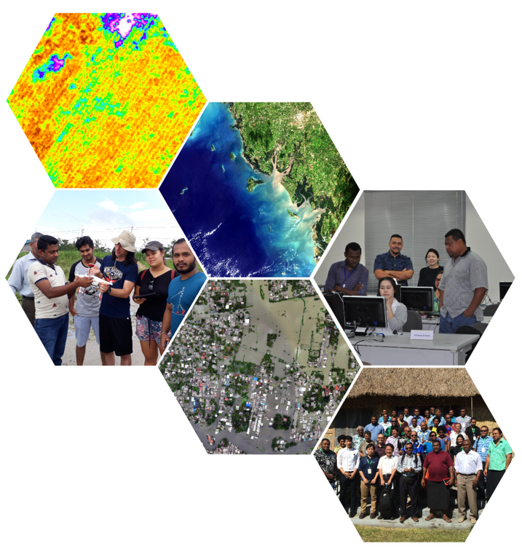
Thank you!
Contact us
kavinda@ait.ac.th
geoinfo@ait.ac.th
www.geoinfo.ait.ac.th
www.facebook.com/gicait
www.ait.ac.th

